Slide 1
Class 3.1: Project Specifications
Antony Hodgson, PhD, PEng
ahodgson@mech.ubc.ca
https://ah-ubc.appointlet.com/s/chat-mech328
Available: Mon 9:00-10:45, 1:00-2:00; Wed 1:30-2:45

Slide 2
Agenda
Review of specification process
Requirements
Evaluation Criteria
Value Equation
Pet Peeves: Analytical Hierarchical Process and Pugh Charts

Slide 3
Design Process
Mission Statement
Identify Needs
Produce, Maintain, Recycle
Set Requirements
Build Prototypes
Generate Concepts
Design in Detail
Evaluate Concepts
Choose Concept
Notes:
Remind students where we are in design process
My thoughts:
This is the essence of design
Most creative and most difficult to teach part of design
Can be improved but some people are naturally better than others
MBTI: Intuitive-types are more likely to be better concept generators than Sensing-types (innovation, creativity, imagination, future achievement)

Slide 4
Design Process
Mission Statement
Identify Needs
Produce, Maintain, Recycle
Set Requirements
Build Prototypes
Generate Concepts
Design in Detail
Evaluate Concepts
Choose Concept
Notes:
Remind students where we are in design process
My thoughts:
This is the essence of design
Most creative and most difficult to teach part of design
Can be improved but some people are naturally better than others
MBTI: Intuitive-types are more likely to be better concept generators than Sensing-types (innovation, creativity, imagination, future achievement)

Slide 5
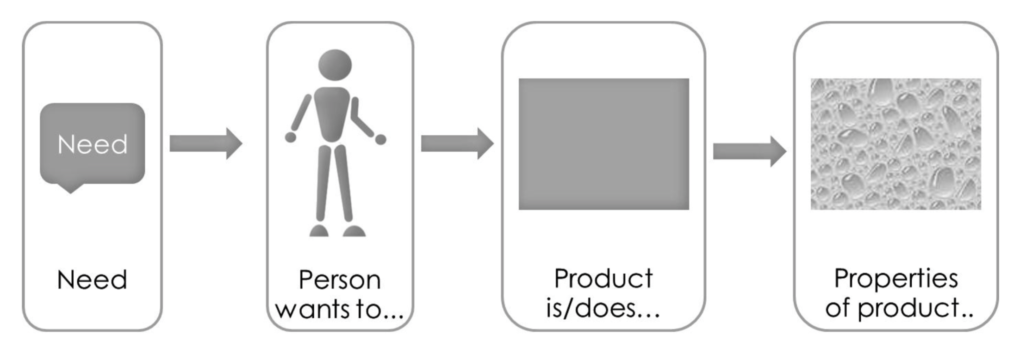
Lindmark & Nillson 2014

Slide 6
MECH 223 Redux
Value Proposition
Identifies in one sentence who benefits from the intended design, and how
Needs
Identified for/from stakeholders through research, dialogue, observation, testing
Requirements
Limits clearly defined so that designer knows when something is good enough
Evaluation Criteria
Top priorities for optimization
Value Equation
Expresses trade-offs between ECs – defines optimal design
Notes:
Value- need to be conscious of what brings most value. Often use dollars (“most important unit on a drawing”)
Needs – understanding the customer’s wants, perceptions and behaviours; engineer has need to make a living, (profit?), safeguard the public and maintain integrity and reputation.
Need Statements – meant to remove artificial barriers such as poor assumptions about restrictions (number of motors used in project 1
Requirements – getting a clear definition of what is good enough limits the amount of work you have to do. Don’t have time to optimize everything –at minimum need something that works acceptably, is delivered on time within budget

Slide 7
Final Report Requirements
Refer to important findings from internal and external searches and any research that you performed. Back this up with references to appendices containing details. Appendices should be used to show detailed results of searches.
If you performed preliminary tests, explorations, field trials, etc. to gain an understanding of the design challenge, provide a separate appendix for each one of these that clearly outlines the purpose of the activity, what you hoped to determine, a brief outline of the test in enough detail that it can be replicated, what the test showed and any conclusions that were drawn. Report them here along with research such as results of tests performed by others, related products, patent abstracts, review of relevant standards, etc.
Notes:
Don’t read in detail – just highlight

Slide 8
Final Report Requirements
Identify key needs and their order of priority.
Outline (briefly) the needs assessment process and present the evaluation criteria used to select the concept. Reference an appendix which captures your detailed needs assessment work. This appendix should contain weekly copies of the needs and requirements list that show the weekly evolution of the needs and requirements through the project.
Reference an appendix in which you clearly reveal how you determined the criteria for comparison of concepts and, in the appendix, justify how you determined the relative importance of the criteria.

Slide 9
Value Proposition
Slack Example: “All your tools in one place” (consumer-oriented)
More realistic engineering problem: “A system (for key stakeholder(s)) that (main function and benefit) while (main constraint)”
Class problem example?

Slide 10
Need Identification
What are you finding? How? Any problems? Need advice?

Slide 11
Need Statements
Translation of expressed needs into description of device/system characteristics or behaviours
Five guidelines:
Describes function, not solution (what, not how)
Specific
Positive, not negative
From point of view of device/system (attribute):
“Device carries rider of up to 250 lbs”
(Avoid words like “must” or “should”)

Slide 12
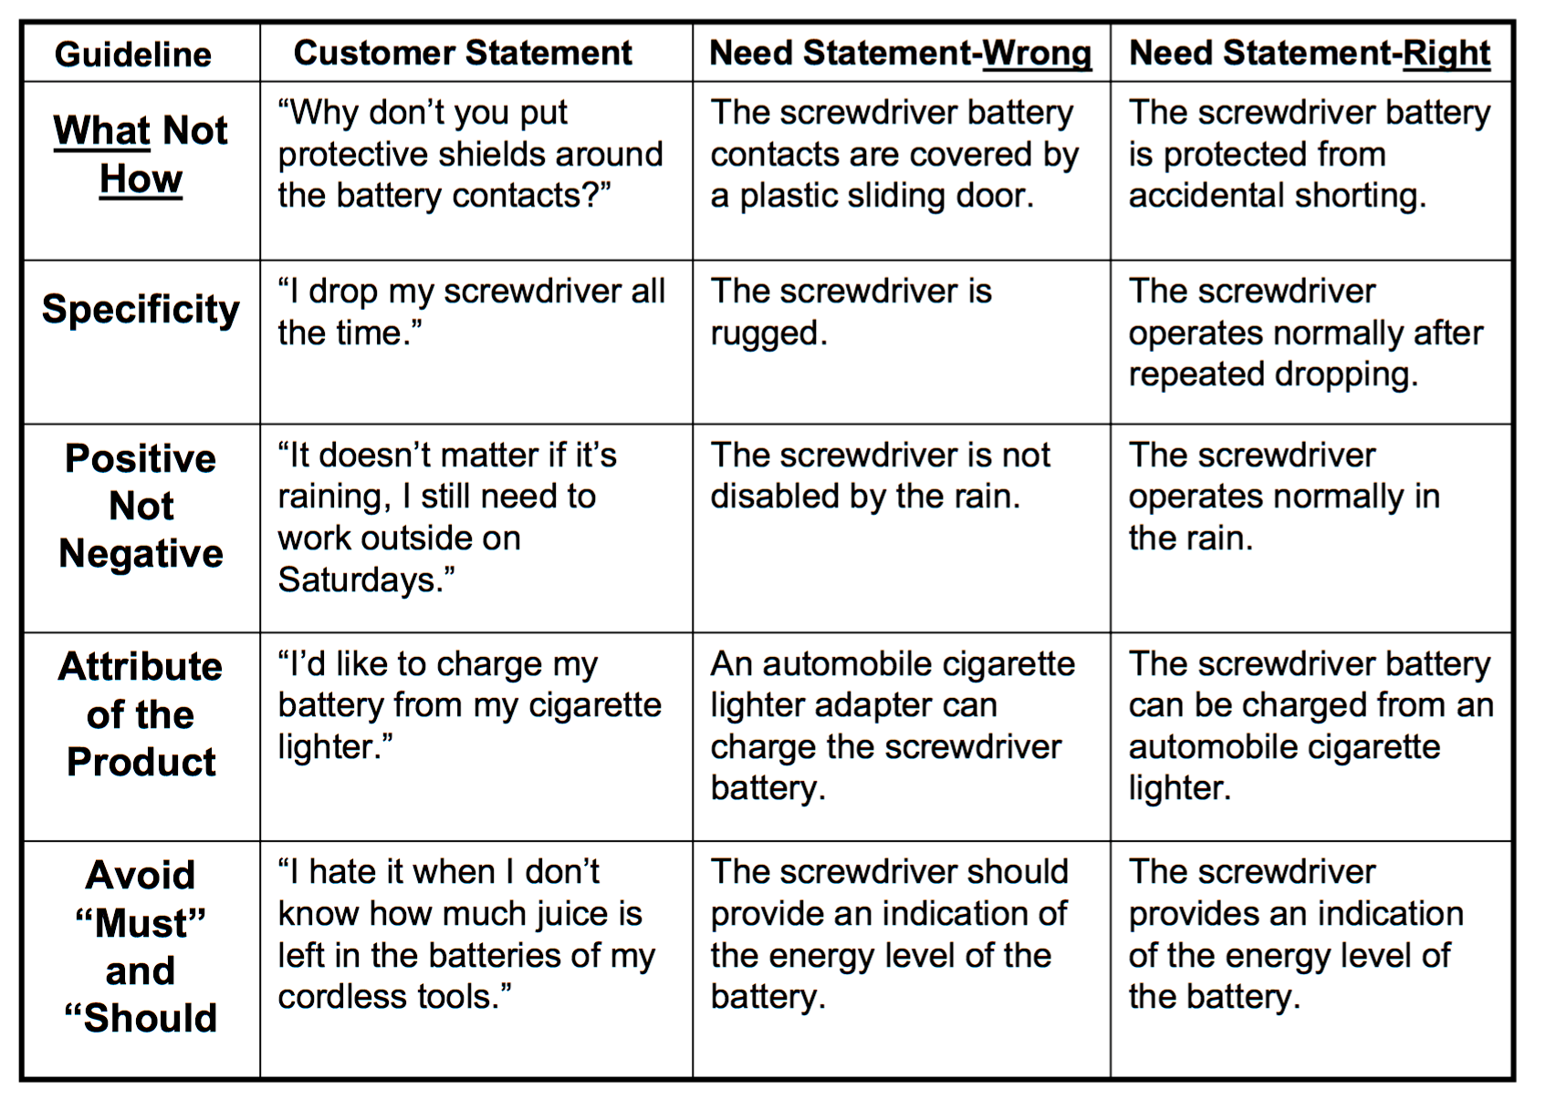
Ulrich 2002

Slide 13
Requirements
Definition: a design feature with a clearly defined limit of acceptability
Must be testable
Which is not a requirement?
The vessel is more than 2 m wide
The vessel is powered by electricity
The vessel is maneuverable

Slide 14
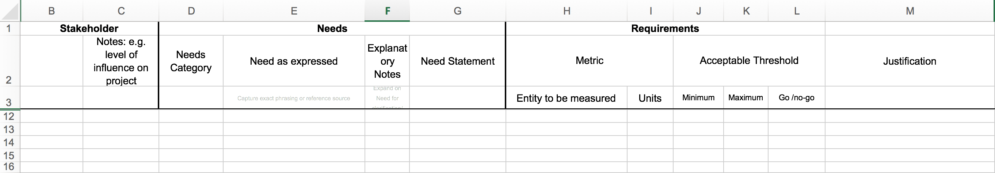
Requirements Template
tinyurl.com/MECH328REQ - Take 5 min and try to write the most important functional requirement for your system (use page for your team; ignore EC for now)

Slide 15
Design Parameters -> Value
Perf
EC
V
Value Eqn
Perf
EC
.
.
.
.
.
.
DP
P
S
Perf
EC
Notes:
Design parameters affect performance variables; performance variables affect satisfaction; satisfaction variables are traded off to maximize value

Slide 16
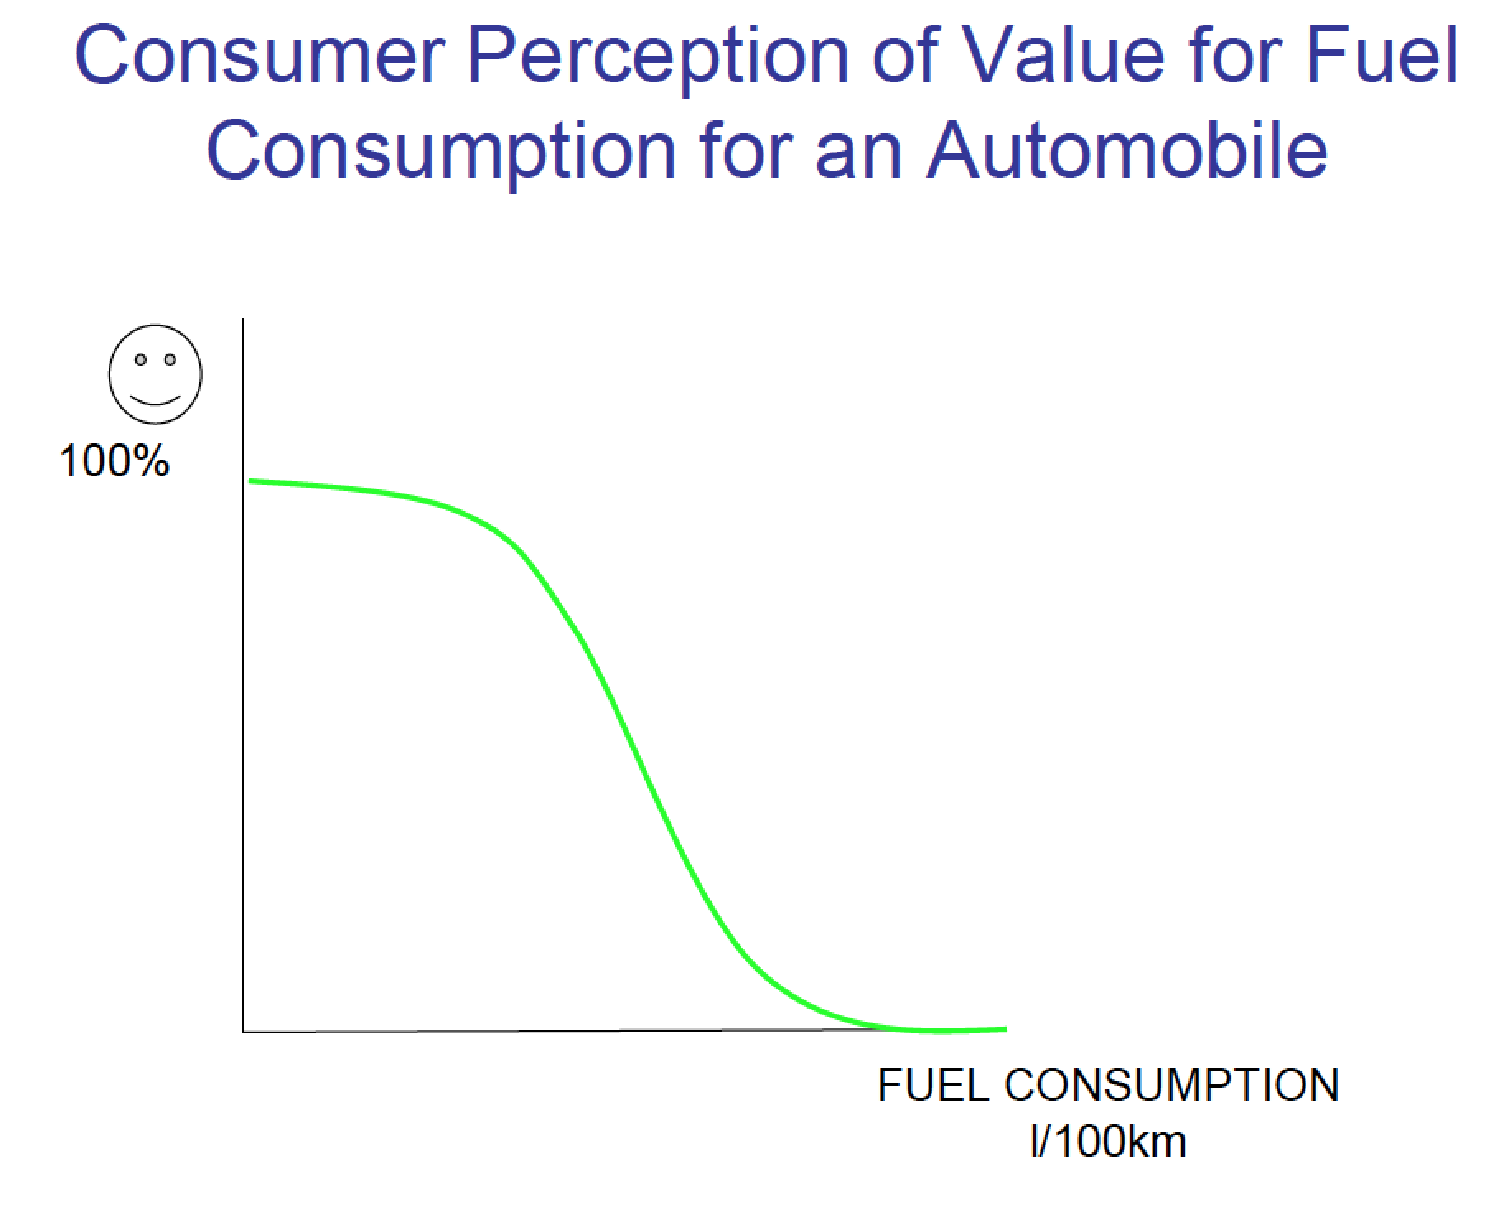
Evaluation Criteria
Reasonable shape of curve
Specify key points on curve (eg, midpoint)
Limit (often has
corresponding requirement);
Has value of 0 at limit
Justify all of these

Slide 17
Evaluation Criterion Exercise
If applicable for your requirement, edit the drawing to produce a corresponding evaluation criterion. Be sure to provide justifications in the spreadsheet for key values and curve shape.

Slide 18
EC -> Value
‘Value equation’ establishes trade-offs between different aspects of a design, guides design direction
V = w₁S₁ + w₂S₂
V = S₁S₂
V = S₁^{w1}S₂^{w2}

Slide 19
Comments on AHP
What AHP is good at:
Translating judgements/opinions into relative weights (WDM)
Capturing ‘squishy’ characteristics (eg, “charisma”)
Documenting decisions
Problems with AHP:
GIGO – can you trust the opinions of those doing the AHP?
“We did an AHP – here’s our result. Trust us.”
Significant complexity, time consuming – requires many pairwise comparisons
Most useful for scoring specific options; much more suspect for comparing ECs
Linear functions
Best practices
Present reasoning as clearly as possible (so reader can decide if they agree)
Evaluate sensitivity!
Use ECs as input at bottom layer of AHP whenever possible
Strongly consider using a direct formulation of value equation

Slide 20
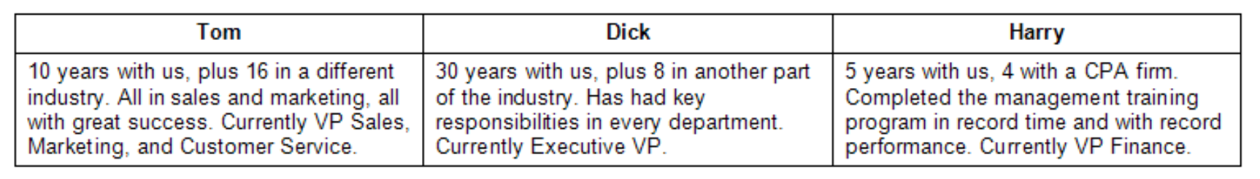
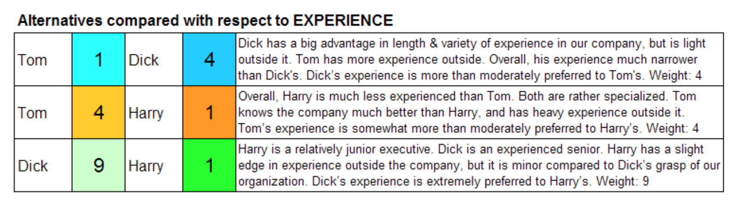
Leadership Selection Example
https://en.wikipedia.org/wiki/Analytic_hierarchy_process_–_leader_example

Slide 21
Pugh Charts
Dressing up judgement calls (lipstick on a pig)
How do I trust you?
At least explain your decisions
Better: Use Weighted Decision Matrices from AHP
Best: Direct validation of value equation

